Slide 1
TAMIL SPEECH TO TAMIL TEXT FOR FILING COMPLAINT FORMS
Team name :- HACKIVISTS Team ID:- TT015 Track name: Tamil and Technology
Team members:- 1. DEVAREDDY SASHANK SAI
2. SABAREESH
3. SANJAI SIDDHARTHAN M

Slide 2
INDEX
Motivation
Introduction
Novelty
Proposed model
Working live session
Pros and cons
References

Slide 3
MOTIVATION
In these days we see many people talking in English and prominence in English but what about people who don’t know English?
We want to create a webpage where people can talk in tamil and it will be written in tamil for them so that they can use that to file complaints.
Many people are illiterates so this helps even more better.

Slide 4
INTRODUCTION
A webpage where a tamil text is generated when we talk in tamil.
We have created webpage using html,css and javascript.
We used speech recognition javascript API concept.

Slide 5
NOVELTY
We can see google translators or any other translators they convert either from your language to English or vice versa.
We have tamil text for tamil spoken people so that they will be able to read what they spoke and use it file complaints.

Slide 6
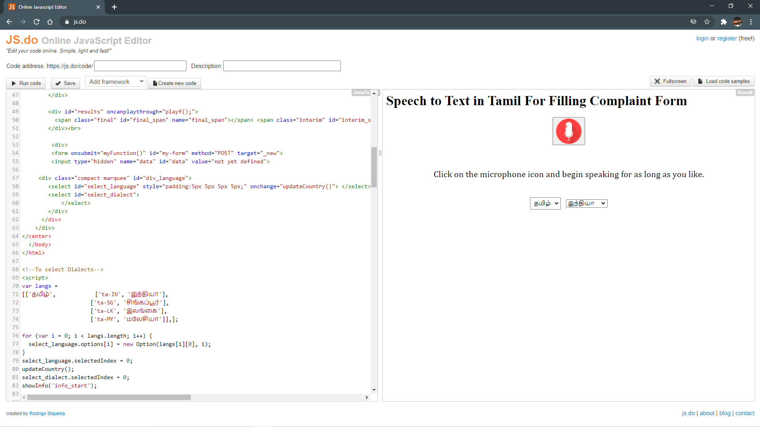
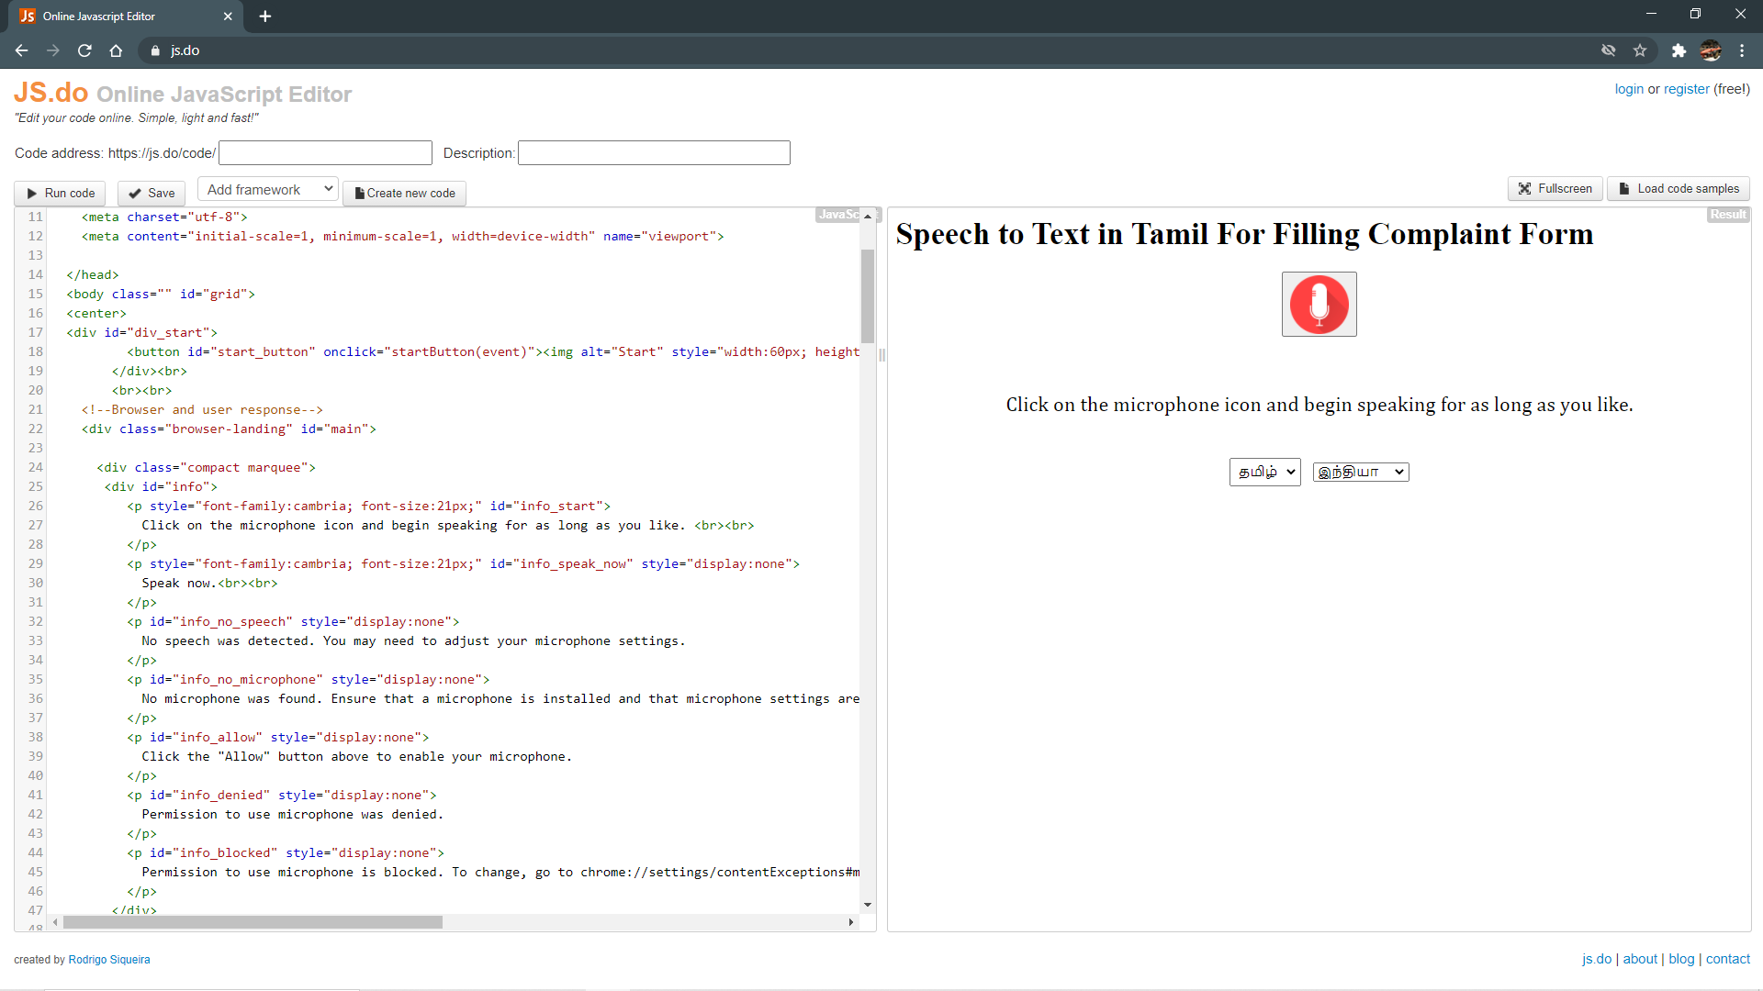
PROPOSED MODEL
We have used online javascript compiler and VS code to code the webpage.

Slide 7
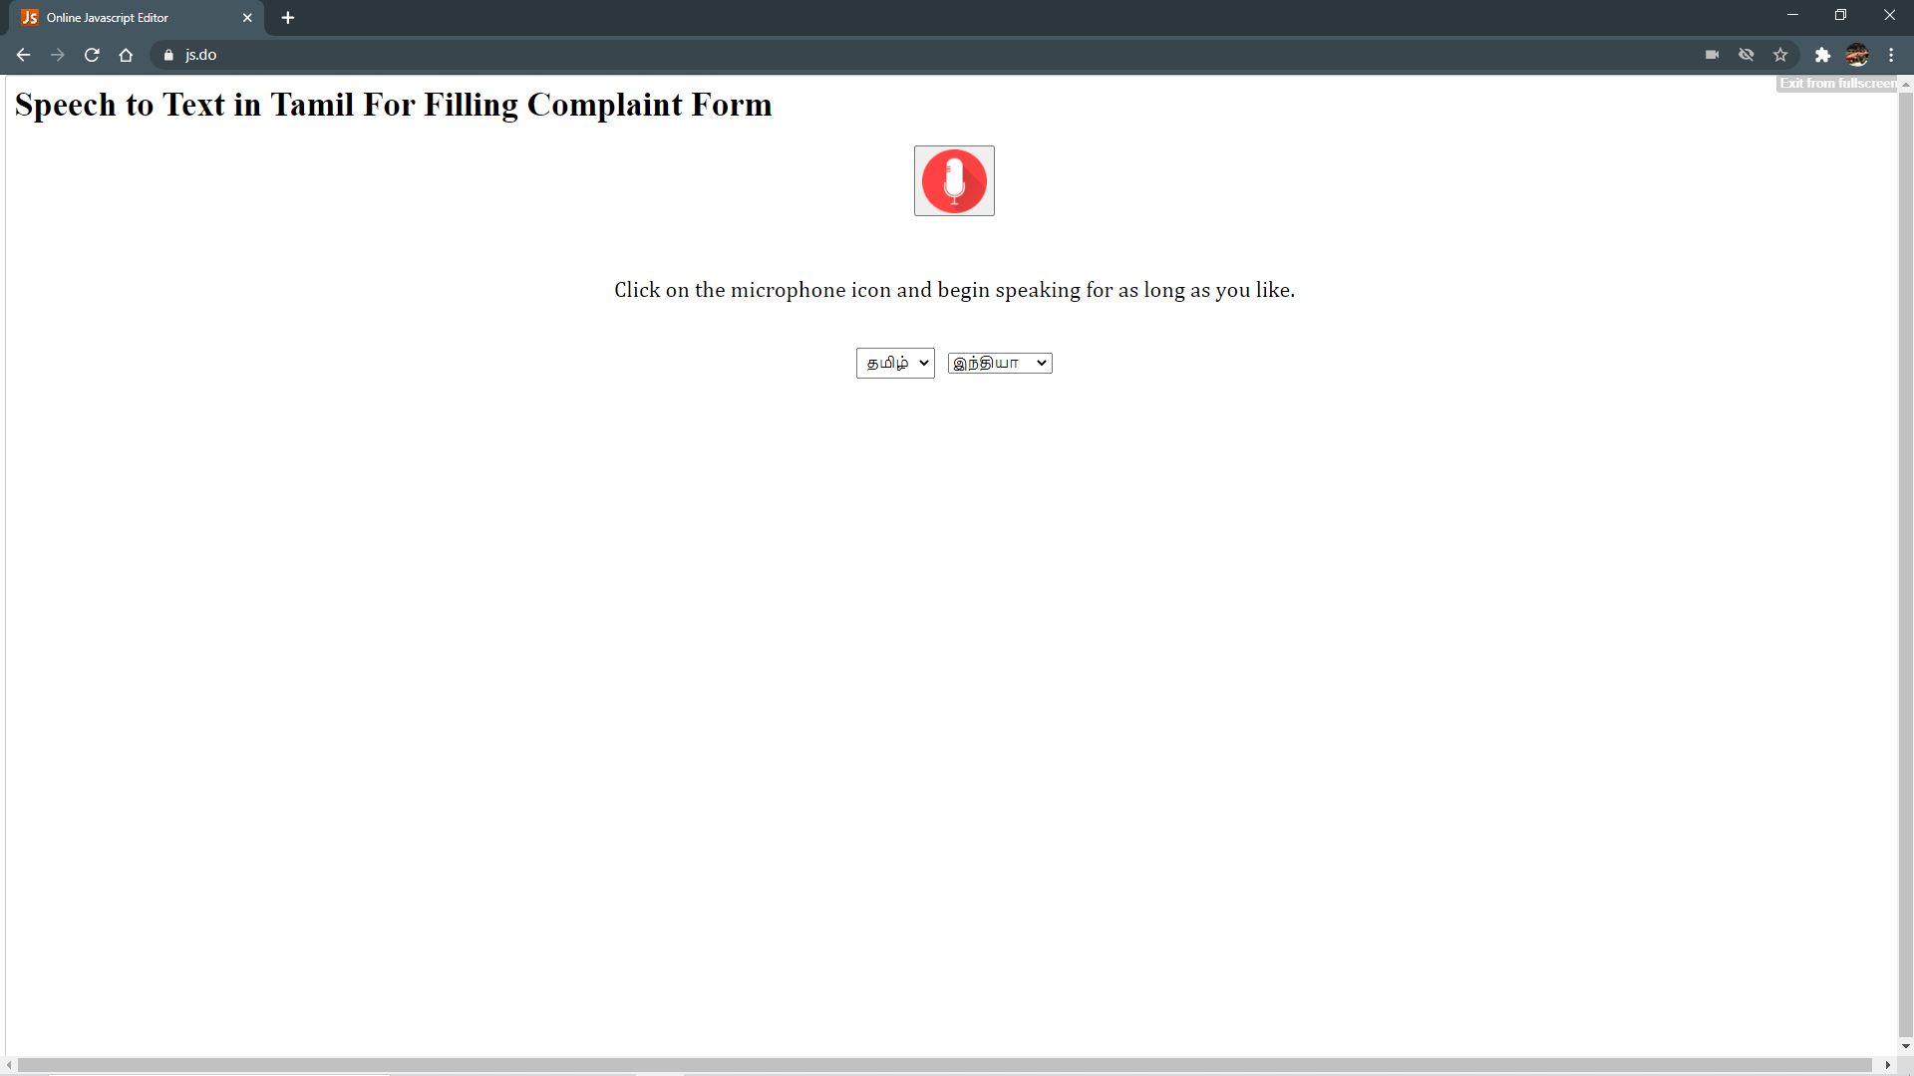
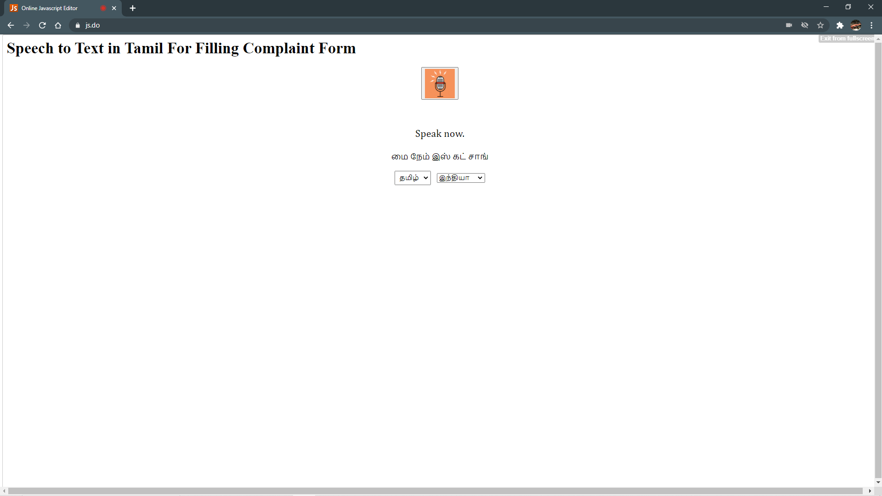
WORKING LIVE SESSION

Slide 8
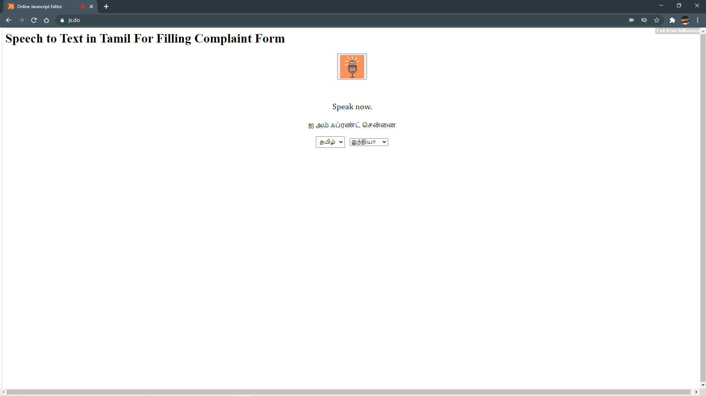
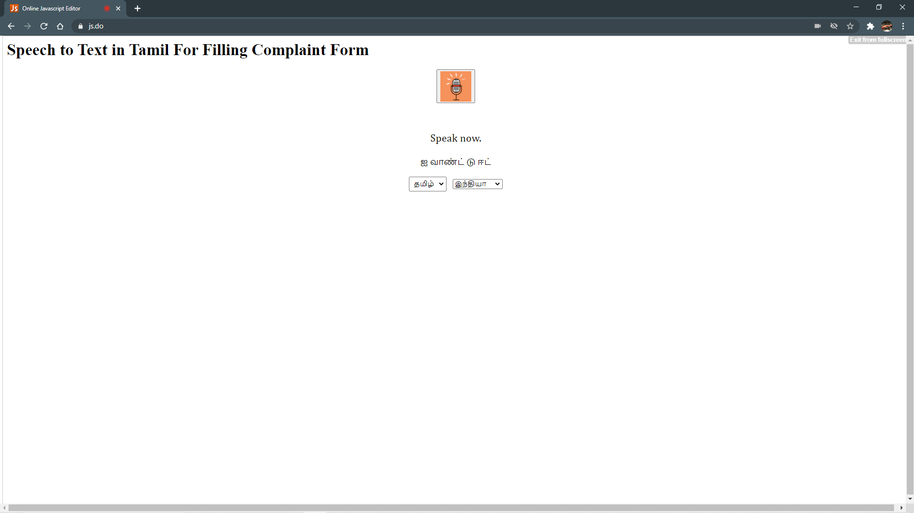

Slide 9
PROS AND CONS
PROS:-
1. It helps the people who don’t know English.
2. It cuts down the time required to type in tamil.
CONS:-
we did not find any cons

Slide 10
REFERENCES
https://js.do/
https://youtu.be/rwB6RqqCmXc
https://www.google.com/intl/en/chrome/demos/speech.html

